Slide 1

COLLEGE STUDENTS SKILL SET VS PLACEMENT

Slide 2
NAME : RUBISHNA K
ROLL NO: 25BDS034
TOPIC: COLLEGE STUDENTS SKILL SET VS PLACEMENT

Slide 3

DATA ANALYSIS
Data analysis is the process of inspecting, cleaning, transforming, and modeling data to discover useful insights, identify patterns, and support decision-making. In this project, I analyzed student data by degree, branch, coding level, internships, CGPA, and job roles to understand how these factors influence placement outcomes. The goal is to extract actionable insights that help improve student training and placement strategies.

Slide 4
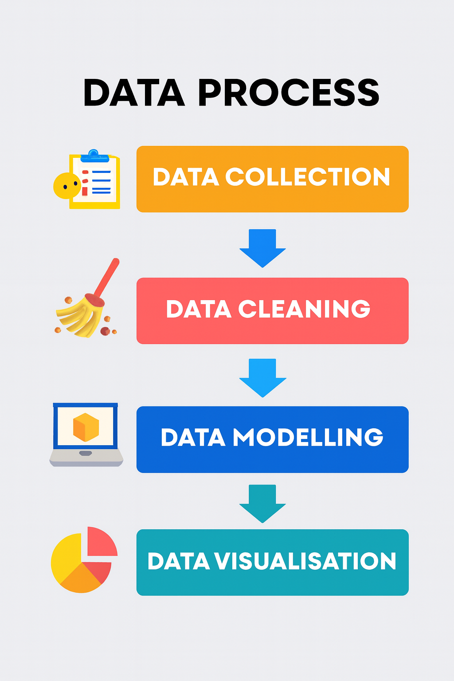

Slide 5
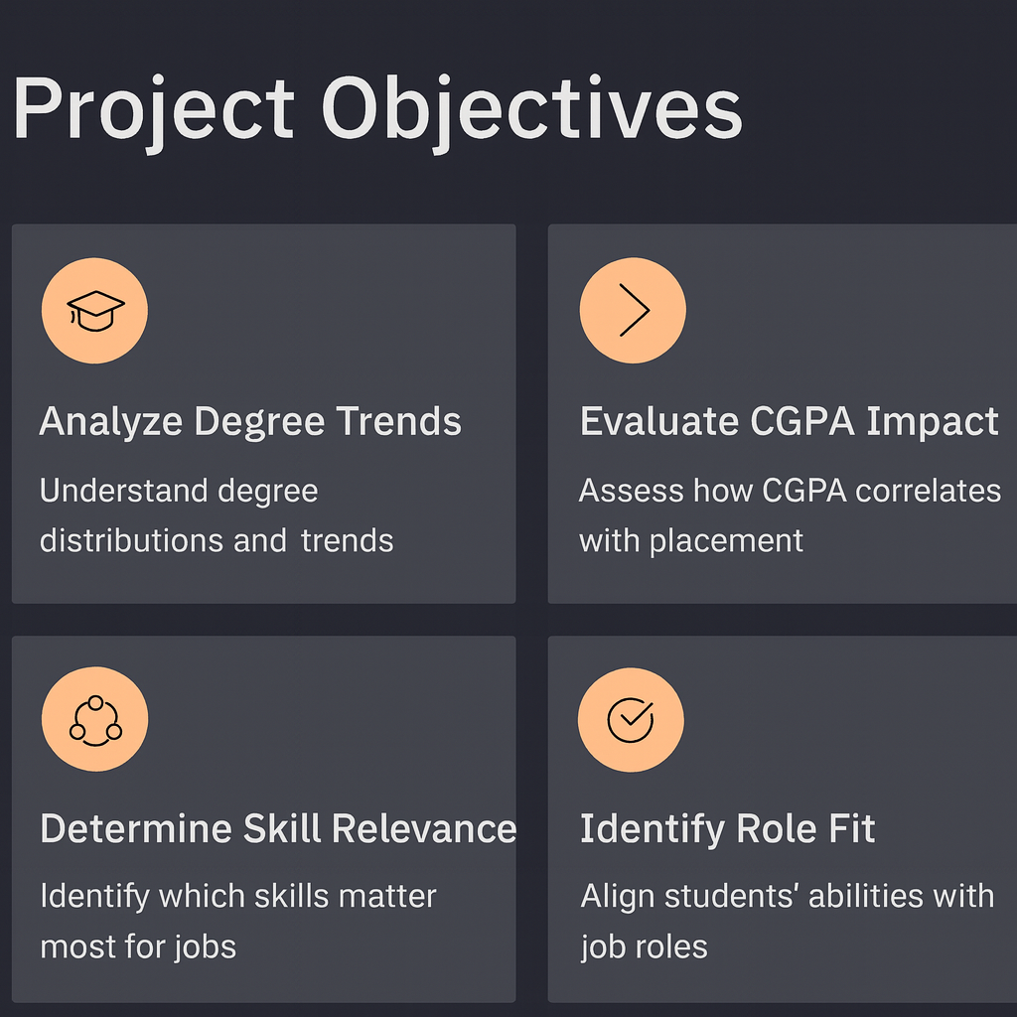

Slide 6
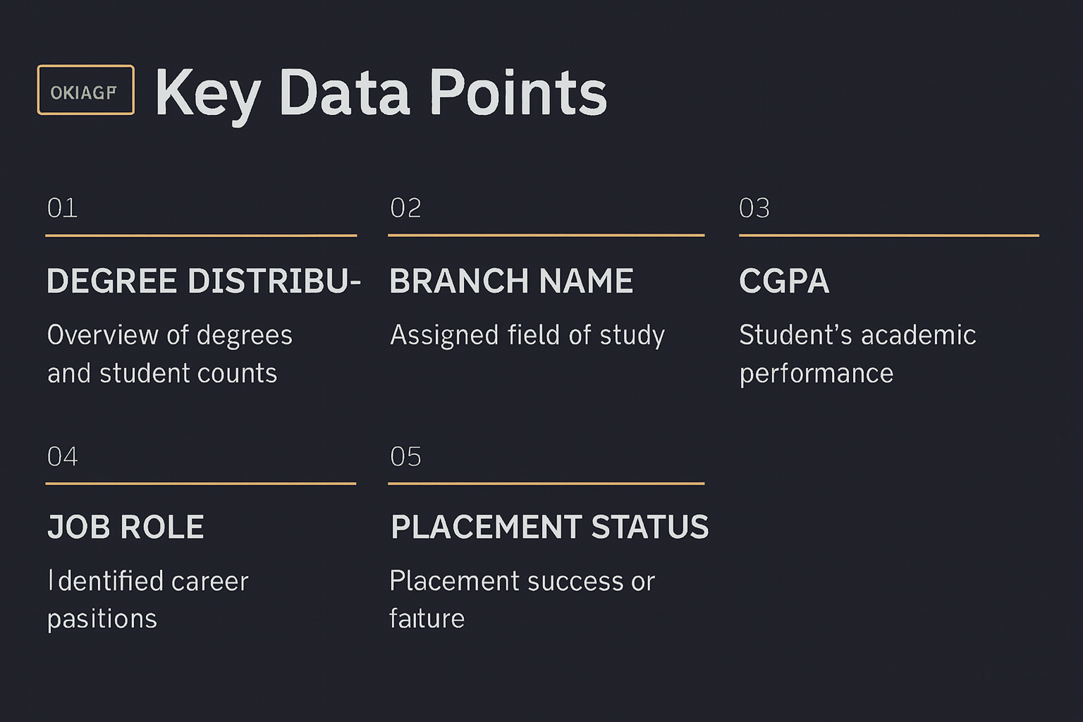

Slide 7
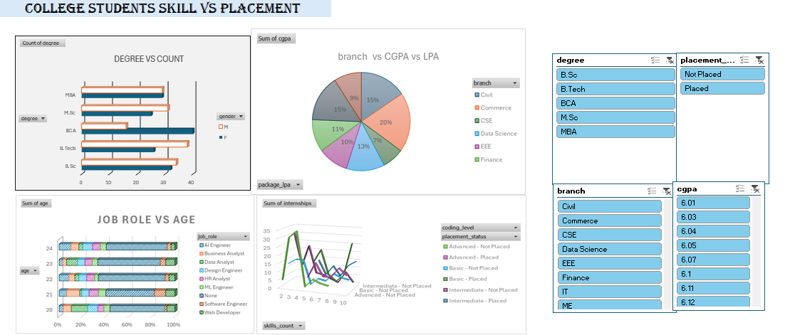

Slide 8
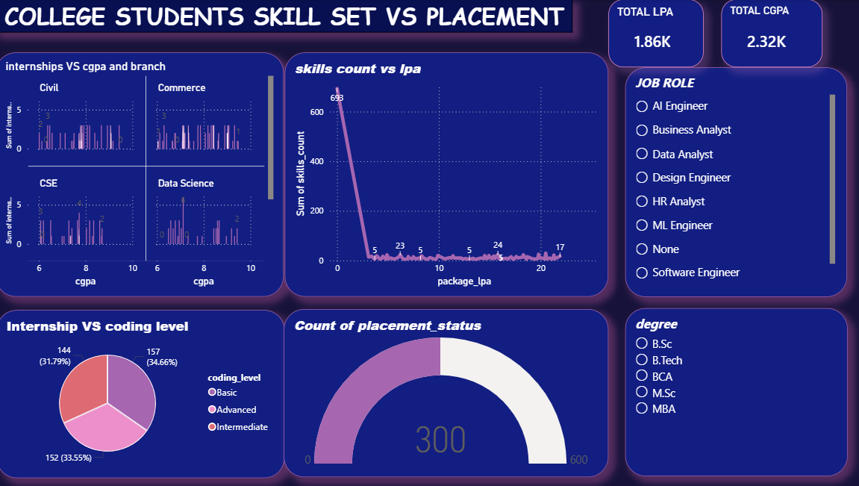

Slide 9
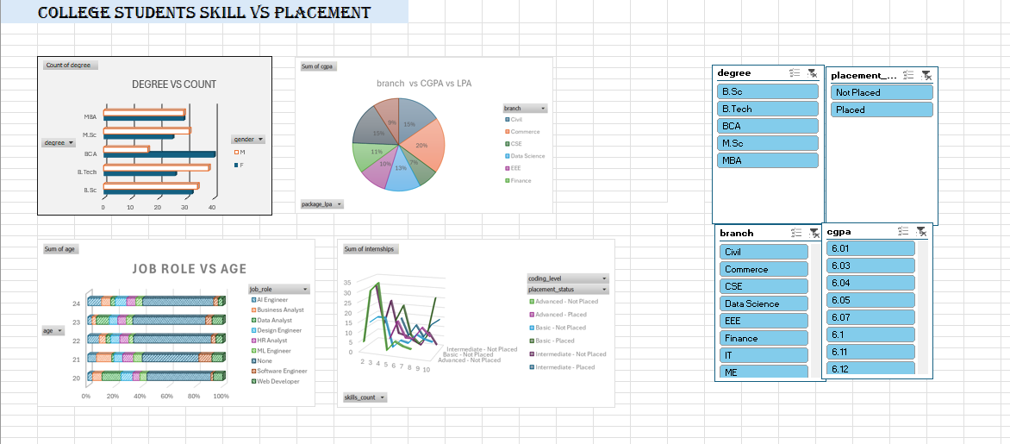
STUDENT SKILL AND PLACEMENT DASHBOARD OVER VIEW
This dashboard visualizes how college students' academic backgrounds and skill levels correlate with placement success. It includes:
Degree vs Count: Shows student distribution across degrees (MBA, M.Sc, BCA, B.Tech, B.Sc) segmented by gender.
Branch vs CGPA vs LPA: Pie chart showing branch-wise CGPA and average salary.
Job Role vs Age: Bar chart mapping job roles to age groups.
Internships vs Skills vs Placement: Line chart showing internship count by skill level and placement status.
Coding Level Distribution: Pie chart showing percentage of students at basic, intermediate, and advanced coding levels.

Slide 10
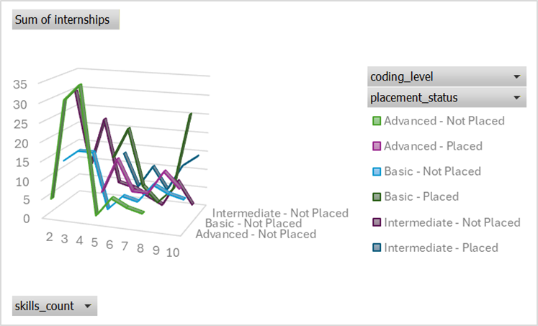
ANALYSIS OF INTERNSHIPS AND CODING LEVEL
The line chart reveals:
Students with advanced coding skills and multiple internships are more likely to be placed.
Basic skill level correlates with lower placement rates.
Internships significantly boost placement chances across all skill levels.

Slide 11
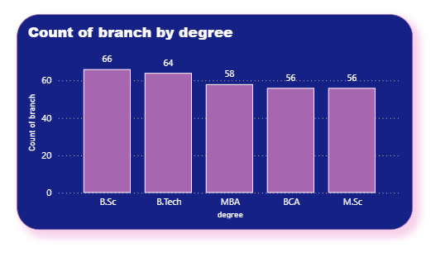
DEGREE AND BRANCH IMPACT
B.Tech and MBA students show higher placement rates.
Branches like CSE, Data Science, and Finance have better CGPA and LPA outcomes.
Civil and Commerce branches show lower placement performance.

Slide 12
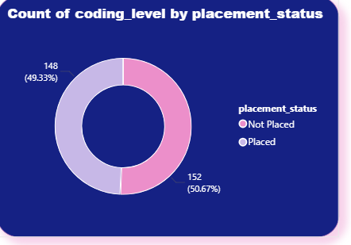
PLACEMENT STATUS
Placed Students: Strong correlation with advanced skills and internships.
Not Placed: Often linked to basic skills and fewer internships.
CODING LEVEL BREAKDOWN
Coding Level | Student Count | Percentage
Basic | 555 | 30.78%
Intermediate | 640 | 35.5%
Advanced | 608 | 33.72%

Slide 13
Conclusion
This analysis reveals that students with advanced coding skills, higher CGPA, and internship experience are significantly more likely to be placed in desirable job roles. Branches like CSE and Data Science show stronger placement outcomes, while basic skill levels and limited practical exposure correlate with lower placement rates. By identifying these patterns, institutions can tailor their training programs to bridge skill gaps and improve employability. The insights from this project empower colleges to make data-driven decisions that align academic development with industry expectations, ultimately enhancing student success in the job market.

Slide 14


